Slide 1

Sport Obermeyer Assignment
Group 6:
Chandra Nikhil Tavvala
Gowtham Ravi
Shail Dimplebhai Modi
Shailesh Yadav

Slide 2
Q1. Inventory Model: The Newsvendor Models
01
02
03
04
Minimum commitment
= 10000 units
Find EOQ* for each style, taking demand and standard deviation into consideration to produce 10000 units
Check if the minimum production quantity constraint (600) for Hong Kong is being violated
Set the minimum quantity as 600 for those styles where we get an optimal order quantity of less than 600

Slide 3
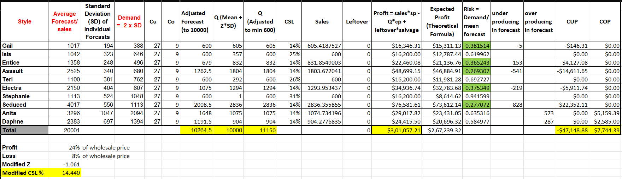
Q2. Initial Phase Orders

Slide 4
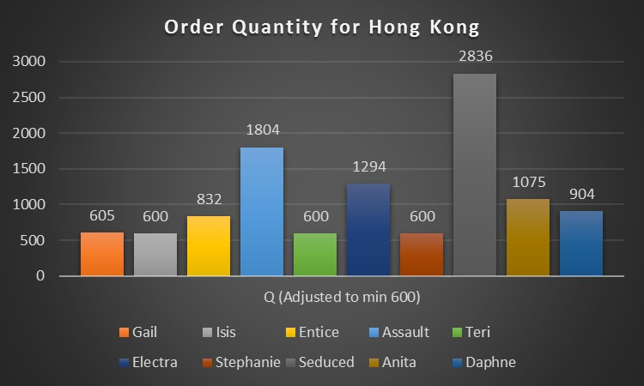
Q2. Initial Phase Orders
Q < 600
Isis, Teri, Stephanie

Slide 5
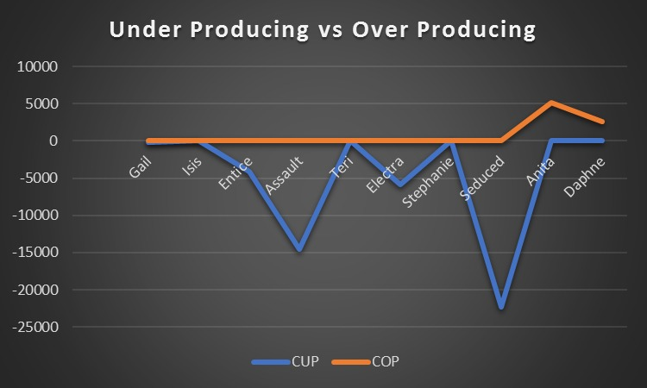
Q2. Initial Phase Orders
Savings
Ordering more when risk is low
$47148.88
Ordering less when risk is high
$7744.39

Slide 6
Q3. Recommendations

Slide 7
01
Improve Demand Forecasting
Use a combination of historical sales data, customer feedback, and market research to improve their demand forecasting capabilities. They could also consider using machine learning and predictive analytics to more accurately predict future demand.

Slide 8
02
Collaborate with Suppliers
Obermeyer could work more closely with their suppliers to reduce lead times and improve their ability to respond to changes in demand. They could also consider using multiple suppliers to increase flexibility and reduce the risk of supply chain disruptions.

Slide 9
03
Implement Postponement Strategies
The styles for which there is high disagreement among the buying committee members have a high standard deviation, thus high risk. For products that gave EOQ much lower than 600, these could be postponed for later, after the Las Vegas show, when a more accurate estimate could be obtained.

Slide 10
04
Implement Dynamic Pricing
Obermeyer could use dynamic pricing strategies to adjust prices based on changes in demand. By raising prices when demand is high, they could reduce the risk of understocking and increase profitability

Slide 11
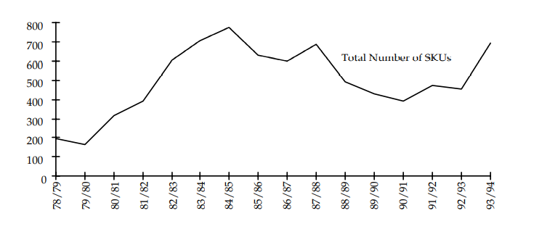
05
Increase Flexibility
The company could increase its flexibility by reducing the number of styles they offer and increasing the speed of its production processes.

